Slide 1

TP02 Internet Programming
Lecturer : Mr. HOK Tin
Student : KOEM Tola
ID : e20190444

Slide 2
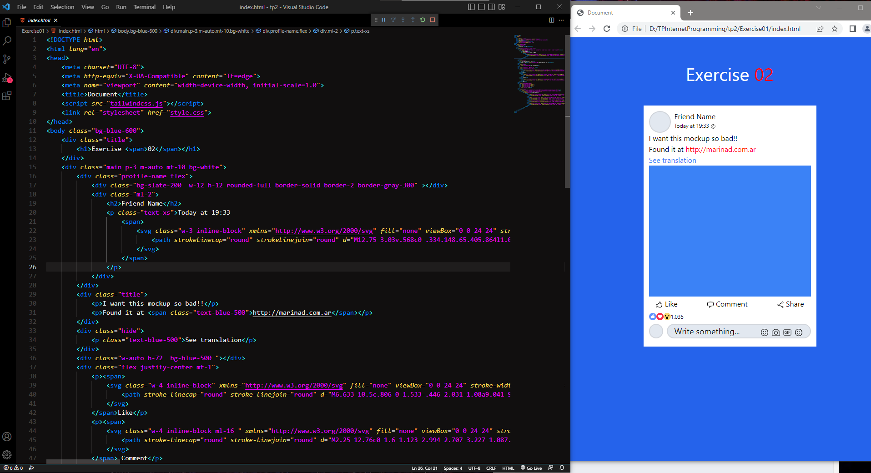
Exercise01

Slide 3
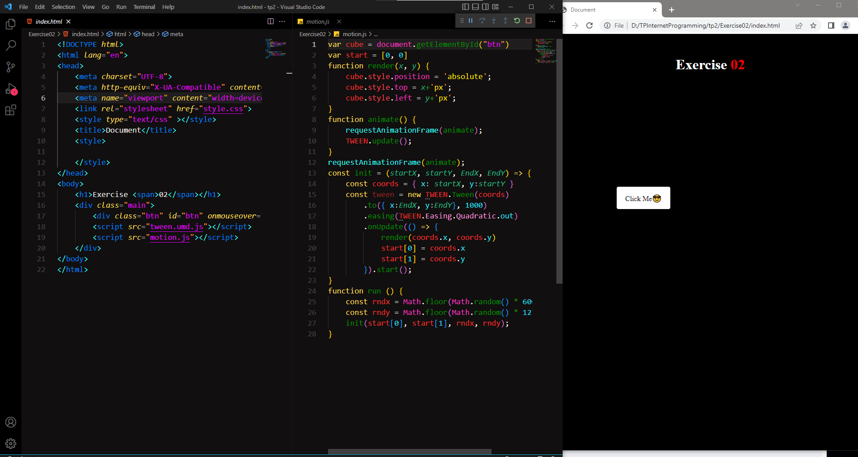
Exercise02

Slide 4
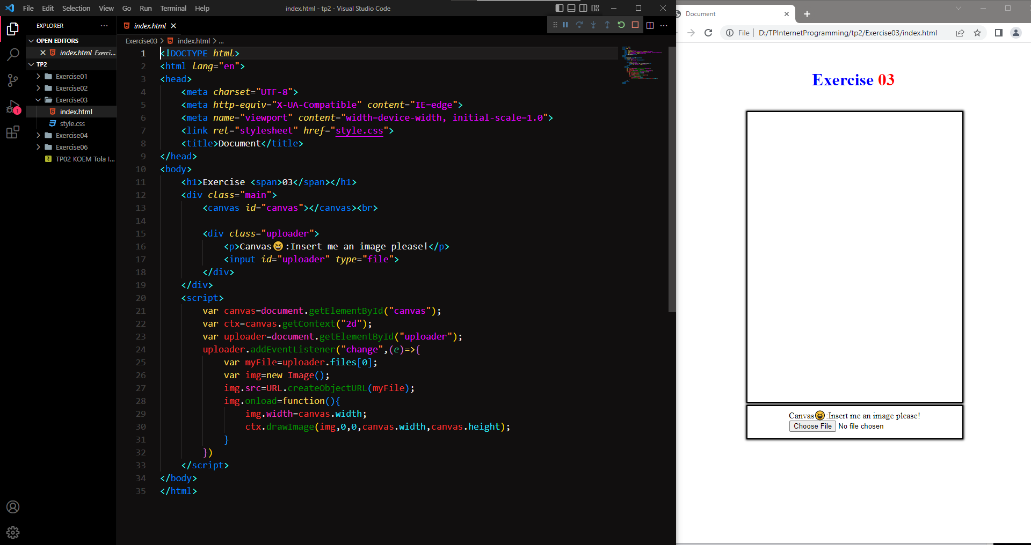
Exercise03

Slide 5
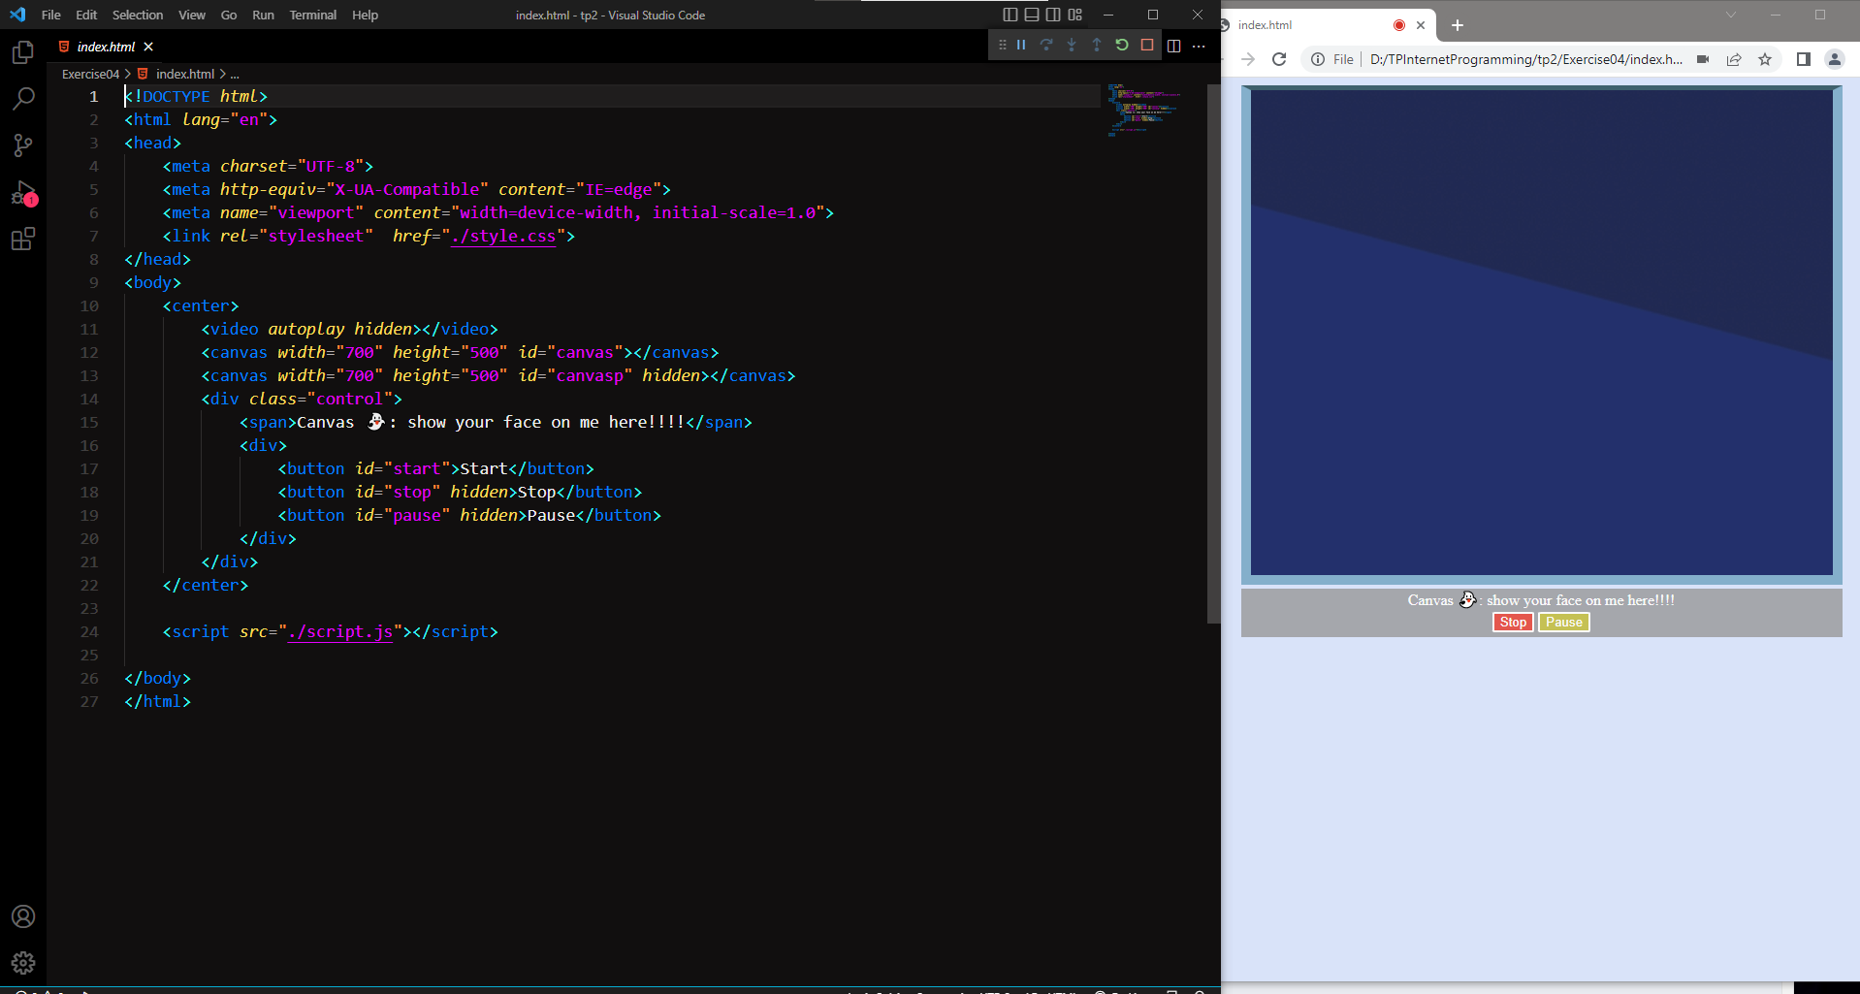
Exercise04

Slide 6
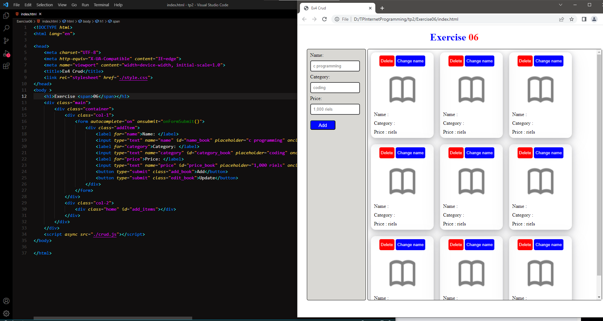
Exercise06

